Slide 1
Make sure to follow your lab handout.
This PowerPoint is ONLY meant to help you in any places you may get stuck!

Slide 2
Experiments: Formation and analysis
The scientific method begins with an observation, which leads the scientist to ask a question.
She or he then comes up with a hypothesis, a testable explanation that addresses the question.
Scientists test hypotheses by making predictions: if hypothesis X is right, then Y should be true.
Then, they do experiments or make observations to see if the predictions are correct. If they are, the hypothesis is supported.
https://www.khanacademy.org/science/biology/intro-to-biology/science-of-biology/a/experiments-and-observations

Slide 3
How is a hypothesis tested?
When possible, scientists test their hypotheses using controlled experiments.
A controlled experiment is a scientific test done under controlled conditions, meaning that just one (or a few) factors are changed at a time, while all others are kept constant.

Slide 4
An example of forming/testing a hypothesis
Suppose I decide to grow bean sprouts in my kitchen, near the window.
I put bean seeds in a pot with soil, set them on the windowsill, and wait for them to sprout.
However, after several weeks, I have no sprouts.
Why not?
Well...it turns out I forgot to water the seeds.
So, I hypothesize that they didn't sprout due to lack of water.

Slide 5
Testing your hypothesis
To test my hypothesis, I do a controlled experiment.
In this experiment, I set up two identical pots.
Both contain ten bean seeds planted in the same type of soil, and both are placed in the same window.
In fact, there is only one thing that I do differently to the two pots:
One pot of seeds gets watered every afternoon.
The other pot of seeds doesn't get any water at all.

Slide 6
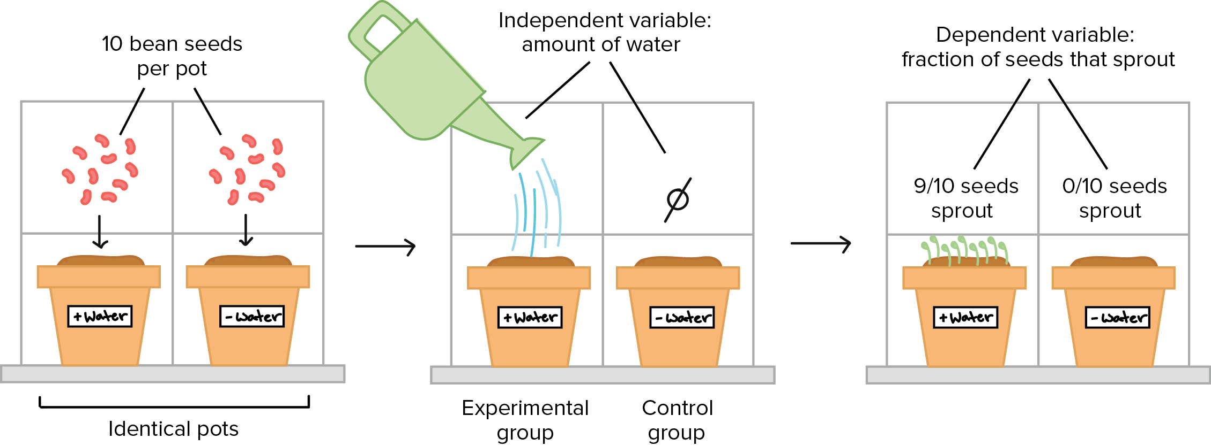
Our experiment

Slide 7
Control versus experimental groups
There are two groups in the experiment, and they are identical except that one receives a treatment (water) while the other does not.
The group that receives the treatment in an experiment (here, the watered pot) is called the experimental group, while the group that does not receive the treatment (here, the dry pot) is called the control group.
The control group provides a baseline that lets us see if the treatment has an effect.

Slide 8
Dependent versus Independent Variables
The factor that is different between the control and experimental groups (in this case, the amount of water) is known as the independent variable.
This variable is independent because it does not depend on what happens in the experiment. Instead, it is something that the experimenter applies or chooses him/herself.

Slide 9
In contrast, the dependent variable in an experiment is the response that's measured to see if the treatment had an effect.
In this case, the fraction of bean seeds that sprouted is the dependent variable.
The dependent variable (fraction of seeds sprouting) depends on the independent variable (the amount of water), and not vice versa.
Experimental data (singular: datum) are observations made during the experiment. In this case, the data we collected were the number of bean sprouts in each pot after a week.

Slide 10
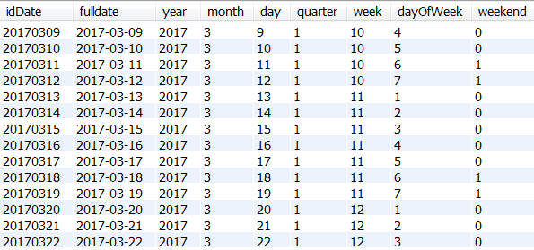
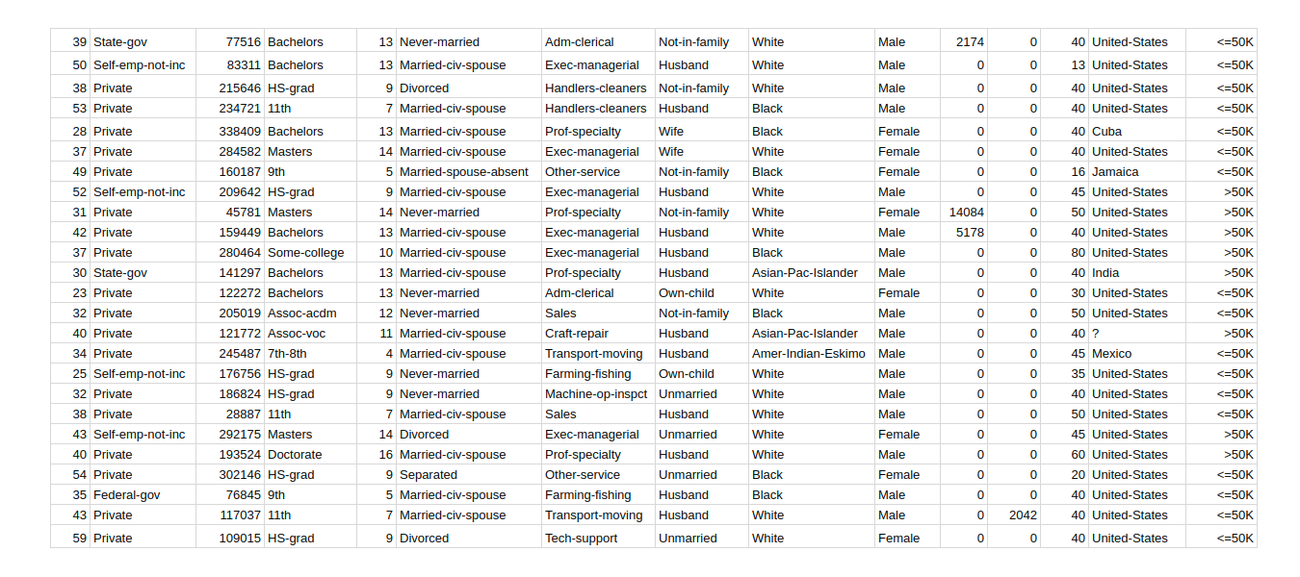
Data/Datasets

Slide 11
Suppose out of the ten watered bean seeds, only nine came up.
What happened to the tenth seed? That seed may have been dead, unhealthy, or just slow to sprout.
Especially in biology (which studies complex, living things), there is often variation in the material used for an experiment – here, the bean seeds – that the experimenter cannot see.
Because of this potential for variation, biology experiments need to have a large sample size and, ideally, be repeated several times.
Sample size refers to the number of individual items tested in an experiment – in this case, 10 bean seeds per group.
Having more samples and repeating the experiment more times makes it less likely that we will reach a wrong conclusion because of random variation.

Slide 12
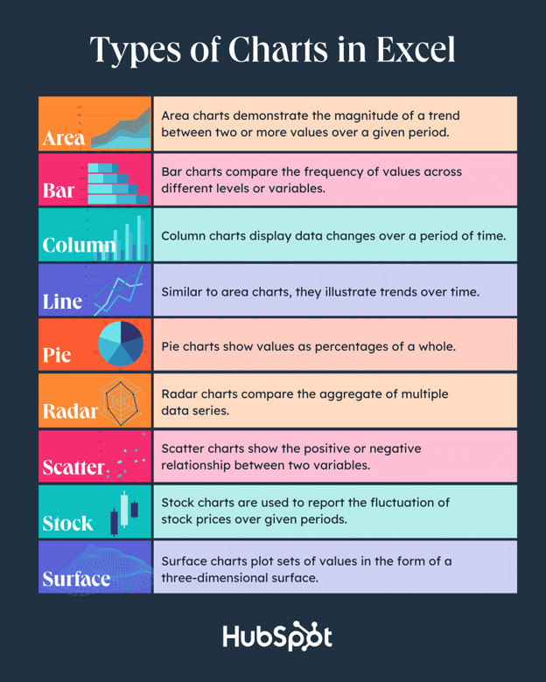
Creating charts in Excel

Slide 13
How to create a graph in Excel
Enter your data into Excel.
Choose one of nine graph and chart options to make.
Highlight your data and click 'Insert' your desired graph.
Switch the data on each axis, if necessary.
Adjust your data's layout and colors.
Change the size of your chart's legend and axis labels.
Change the Y-axis measurement options, if desired.
Reorder your data, if desired.
Title your graph.
Export your graph or chart.
https://blog.hubspot.com/marketing/how-to-build-excel-graph

Slide 14
1. Enter your data into Excel.
First, you need to input your data into Excel.
You might have exported the data from elsewhere, like a piece of marketing software or a survey tool.
Or maybe you're inputting it manually.

Slide 15
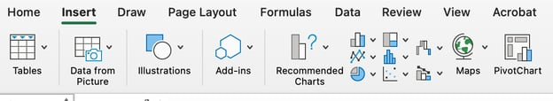
2. Choose from the graph and chart options.
In Excel, your options for charts and graphs include column (or bar) graphs, line graphs, pie graphs, scatter plots, and more.
See how Excel identifies each one in the top navigation bar, as depicted below:

Slide 16
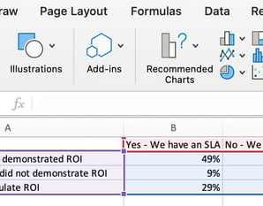
3. Highlight your data and insert your desired graph into the spreadsheet.
In this example, a bar graph presents the data visually. To make a bar graph, highlight the data and include the titles of the X and Y-axis.
Then, go to the Insert tab and click the column icon in the charts section. Choose the graph you wish from the dropdown window that appears.

Slide 17
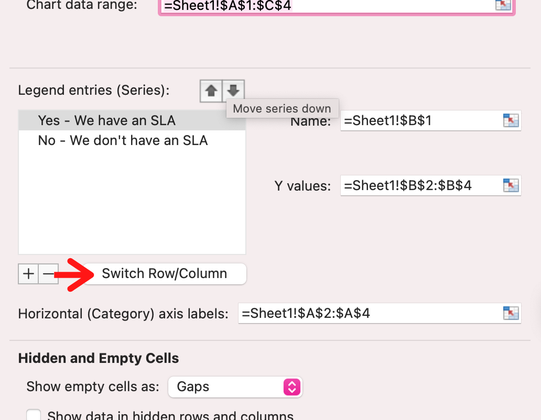
4. Switch the data on each axis, if necessary.
If you want to switch what appears on the X and Y axis, right-click on the bar graph, click Select Data, and click Switch Row/Column.
This will rearrange which axes carry which pieces of data in the list shown below. When finished, click OK at the bottom.

Slide 18
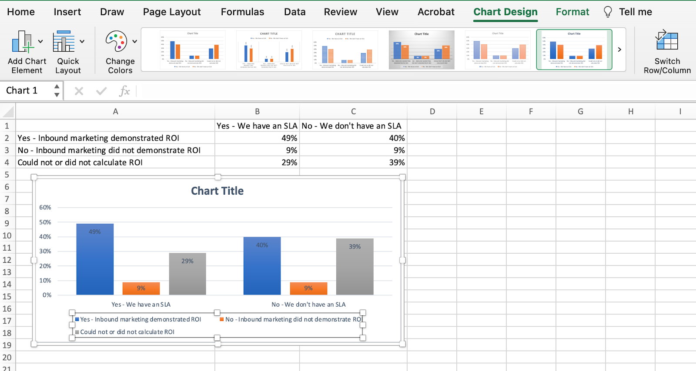
5. Adjust your data's layout and colors.
To change the labeling layout and legend, click on the bar graph, then click the Chart Design tab.
Here, you can choose which layout you prefer for the chart title, axis titles, and legend.
In my example below, I clicked on the option that displayed softer bar colors and legends below the chart.

Slide 19
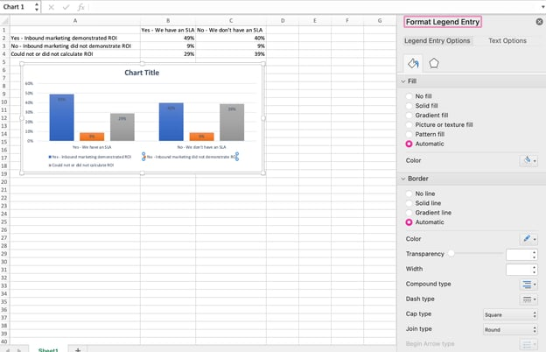
To further format the legend, click on it to reveal the Format Legend Entry sidebar, as shown below.
Here, you can change the fill color of the legend, which will change the color of the columns themselves.
To format other parts of your chart, click on them individually to reveal a corresponding Format window.

Slide 20
6. Change the size of your chart's legend and axis labels.
When you first make a graph in Excel, the size of your axis and legend labels might be small, depending on the graph or chart you choose (bar, pie, line, etc.) Once you've created your chart, you'll want to beef up those labels so they're legible.
To increase the size of your graph's labels, click on them individually and, instead of revealing a new Format window, click back into the Home tab in the top navigation bar of Excel. Then, use the font type and size dropdown fields to expand or shrink your chart's legend and axis labels to your liking.

Slide 21
7. Change the Y-axis measurement options if desired.
To change the type of measurement shown on the Y axis, click on the Y-axis percentages in your chart to reveal the Format Axis window.
Here, you can decide if you want to display units located on the Axis Options tab, or if you want to change whether the Y-axis shows percentages to two decimal places or no decimal place

Slide 22
8. Reorder your data, if desired.
Right-click on your graph and click Select Data to reveal the same options window you called up in Step 3 above.
This time, arrow up and down to reverse the order of your data on the chart.

Slide 23
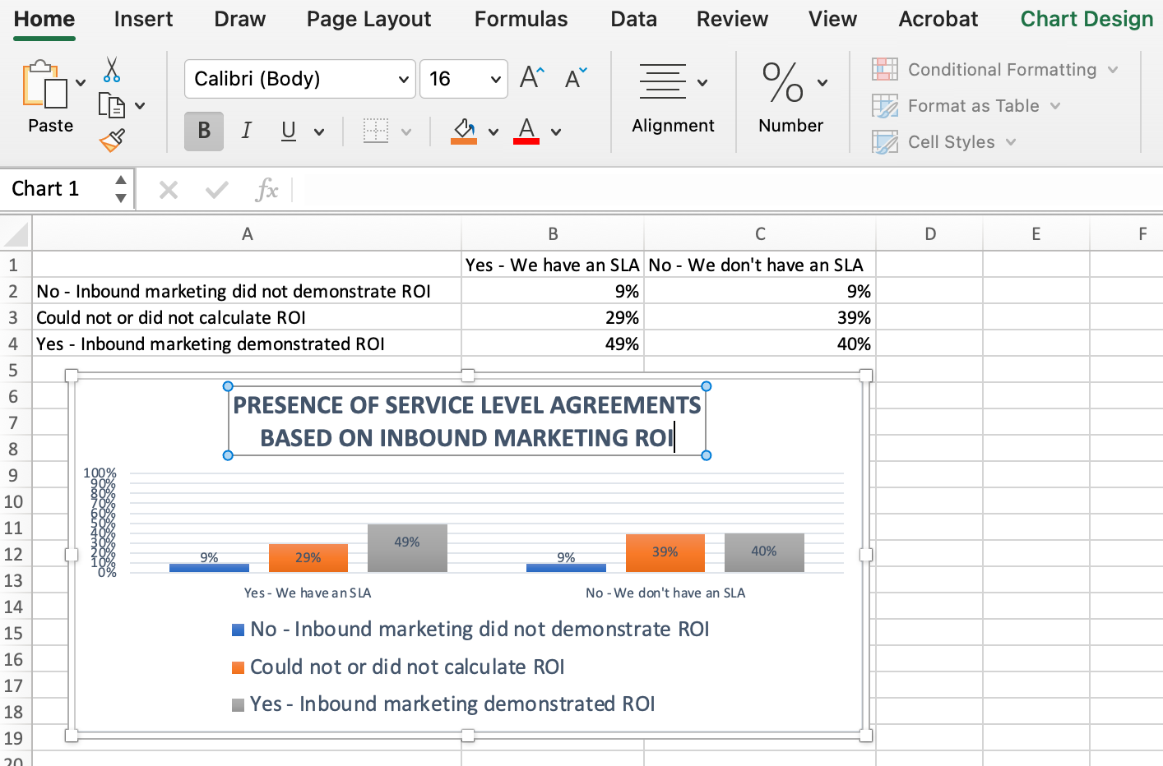
9. Title your graph.
Right after making your chart, the title that appears will likely be "Chart Title," or something similar.
To change this label, click on "Chart Title" to reveal a typing cursor. You can then freely customize your chart's title.
When you have a title you like, click Home on the top navigation bar, and use the font formatting options to give your title the emphasis it deserves.

Slide 24
Today’s lab
Part 1- Access Excel
Part 2- Types of graphs and interpreting graphs
Part 3- Creating your own graphs (You have to do both of these activities):
1. Create your own graph out of dice rolls.
2. Create a graph out of data I provide.

Slide 25
Part 3 – Creating your own graph
Set up 3 columns titled Dice 1, Dice 2, and Dice 3.
In the cell beneath the words “Dice 1,” enter the following:
=rollbetween(1,6)
This will randomly pick a number between 1 and 5 (like rolling a dice).
Drag the corner of the cell that contains =rollbetween(1,6) and pull the box so that it covers the cell to the right (under Dice 2) and then to the right 1 more time (under Dice 3).
Repeat the previous process, this time going down instead of right, until you have a total of 10 numbers under each of the Dice #s. Do this for each dice.
The numbers may change as you add information to the spreadsheet. This is okay.

Slide 26
Your chart should look like this:
roll # | Dice 1 | Dice 2 | Dice 3
1 | 3 | 3 | 5
2 | 3 | 4 | 2
3 | 4 | 5 | 5
4 | 1 | 6 | 5
5 | 5 | 3 | 5
6 | 3 | 4 | 5
7 | 5 | 6 | 4
8 | 6 | 3 | 6
9 | 2 | 5 | 3
10 | 6 | 4 | 6

Slide 27
Part 3 – Using prepared data to create a graph
Enter your data manually in the same way it is formatted.
Select the entire dataset including words.
Click on “insert” and select the appropriate graph.
To add labels, click on chart design > add chart element, and use the drop down menu.
If it doesn’t look right, or you want to change a part of it, look at the previous slides for help!

Slide 28
Assume preoperative/postoperative refers to when the pain medication was given

Slide 29
11/12
9/10
7/8
5/6
3/4
1/2
TA BENCH

